Slide 1

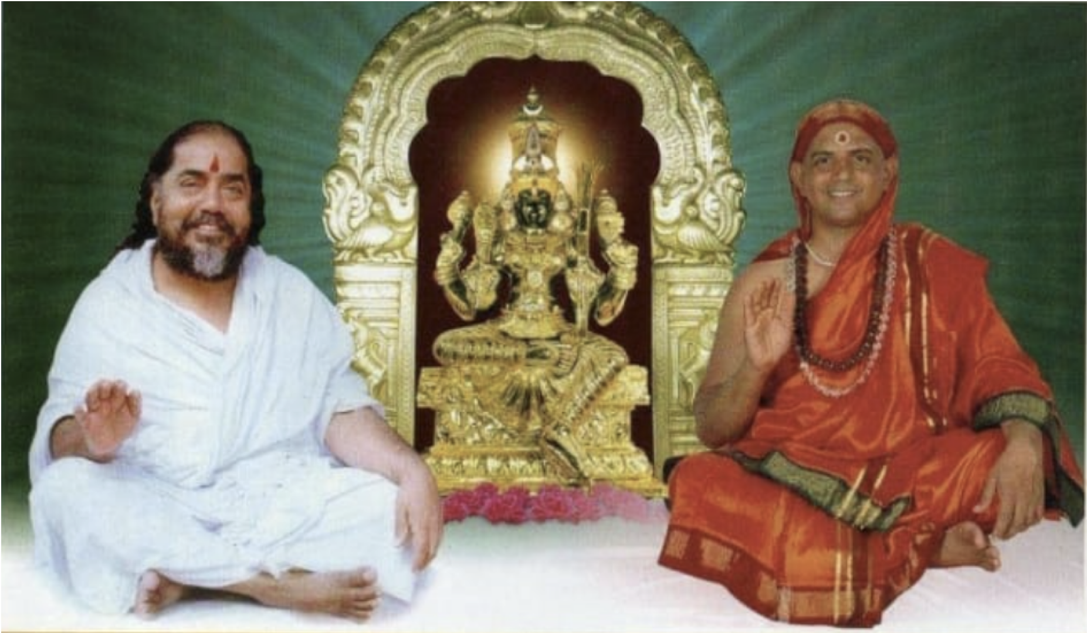
NAMASKAR

Slide 2

Presents
Temple Management System
Pitch Deck
January 2024

Slide 3

OVERVIEW
Promoters
Project – Brief
Project – Unique Selling Proposition (USP’s)
Implementation – Strategy & Timeline
Project Investment
On-Prem Datacenter @ Kailash Ashram
HTAS - Benefits

Slide 4
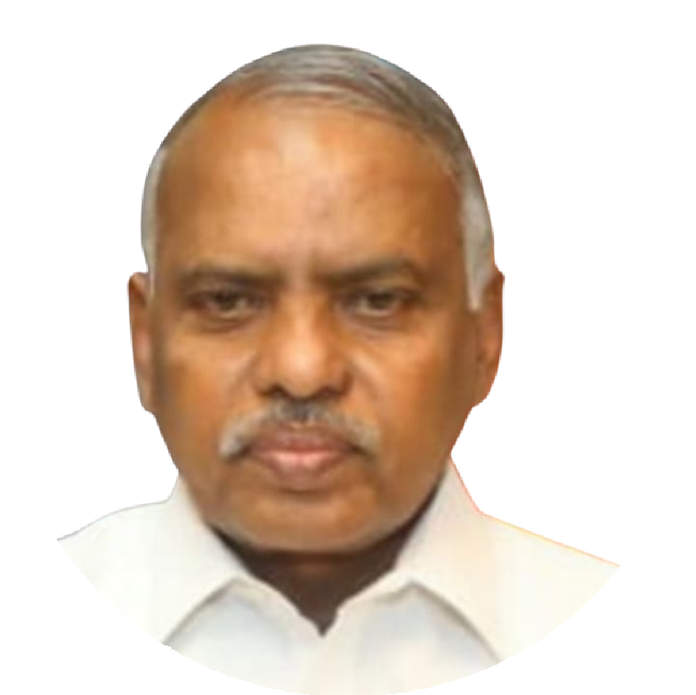
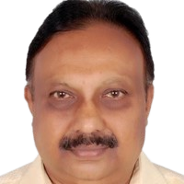
Mr. P. Manickavelu
PROMOTORS
Mr. Giridhar Rao B.N.
Founder & Managing Director
Unique mix of exposure in Electronics, Telecom, Computers, Software and IT.
33 plus years in Indian Telephones Industries , Bangalore under Ministry of Communication, Govt. of India.
15 years in R&D Involving Electronics Hardware & Software. Built many Voice & Data Networks and Data Centers of National Importance
12 years in building IT Infrastructure for BSNL, Defense, Railways, Govt. Depts. etc.
6 years in Corporate Marketing.
Executive Director
Unique mix of exposure in Mechanical, electrical and electronics discipline.
5 years worked for various corporate companies (India & abroad), specializing in HVAC Installation & Commissioning.
30 plus years as Entrepreneur in the field of Manufacturing Industry, Contracting companies, Recycling of Non-Ferrous Metals, Design & Development of Electric Vehicles (EV) and IOT
Qualification: Mechanical Engineering.
.

Slide 5
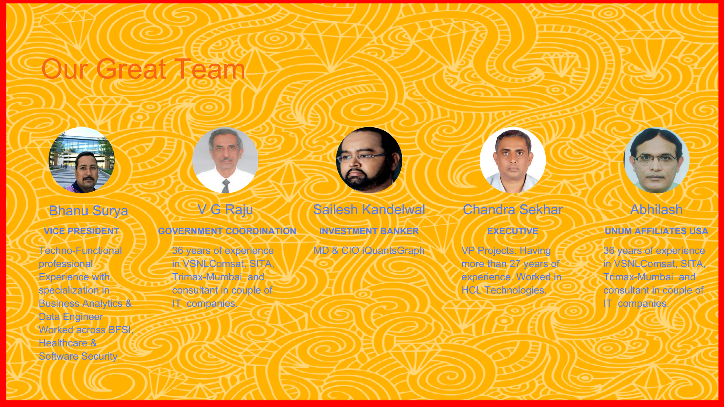
.

Slide 6
Project - Brief
Facial recognition is a biometric technology, which is based on the identification of facial features of a person.
It falls under broad category of Identity Management System (IMS)
Solution
Development Phase
Innovative Process driven Software Solution to identify individuals flawlessly using “Live Facial Images”
Live Facial Image Recognition software for identification and verification of individuals.
Phase 1 – Presence / Attendance marking of all Stake holders of Kailash Ashram
Phase 2 -- Presence / Attendance marking of all Stake holders of 5 temples for PoC
Phase 3 - Nationwide rollout of TMS Software application

Slide 7
Project – Unique Selling Proposition (USP’s)
Temple management System is based on Patentable Live FRT (Facial Recognition Technology).
No special devices like finger print scanner is required to verify the Individuals.
Commonly available Smart Mobile Phones are used as end user verification devices.
Cost effective Services to end users.
Zero Investment Scheme to customers, thereby offering no Investment Risk.
No Existing Competitors

Slide 8
IMPLEMENTATION – STRATEGY & TIMELINE
Phase 1
Phase 2
Phase 3
Presence / Attendance marking of all Stake holders of Kailash Ashram
Presence / Attendance marking of all Stake holders of 5 temples for PoC
Pan India rollout of Temple Management System Project
Timeline – Phase 1
Timeline – Phase 2
PoC
Commercial Launch
PoC
Commercial
Launch
JAN
FEB
MAR
APR
MAY
JUN
JAN
FEB
MAR
APR
MAY
JUN
2024
2024
Pilot Run
Pilot Run

Slide 9
Project Investment
Expense Head | Phase 1 (INR Lakhs) | Phase 2 (INR Lakhs) | Total (INR Lakhs)
Infrastructure Equipment Cost (Servers, Storage equipment, Load balancer, Firewalls, Monitors, Laptops & UPS, Racks, Furniture etc.) | 20.00 | 40.00 | 60.00
Communication Equipment Cost (IP Switch, IP Routers, Modems, Wi-Fi Equipment, GProCode Readers, Racks etc,) | 12.50 | 25.00 | 37.50
Installation, Testing, Commissioning & AMC | 5.00 | 10.00 | 15.00
Working Capital (Salaries, Office Rentals, Electricity, Hospitality, Communication, Travel etc.) | 7.50 | 15.00 | 22.50
Miscellaneous (~ 10%) | 5.00 | 10.00 | 15.00
Total | 50.00 | 100.00 | 150.00

Slide 10
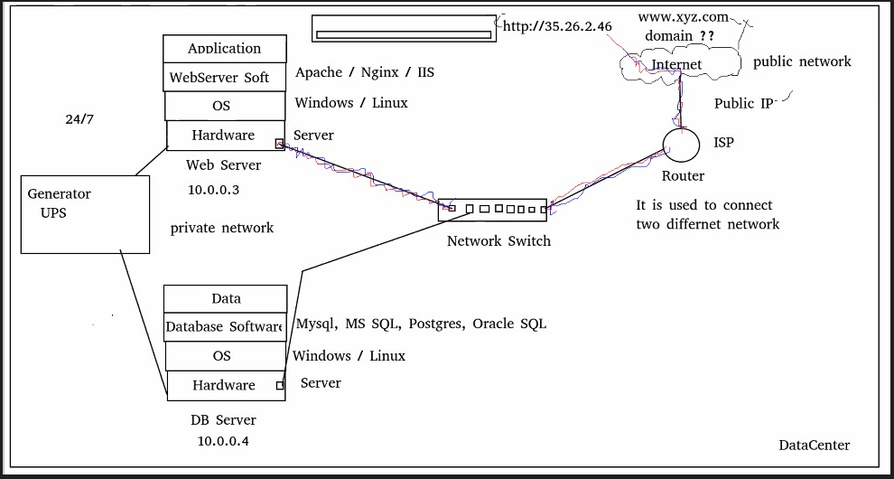
On-Prem Datacentre @ Kailash ashram
NOTE: This schematic diagram is for representation only. Datacenter will be on rent/hire, and not owned by GProTech

Slide 11
Holistic Temple-Ashram Administrative System (HTAS) - benefits
Organization Structure & SH Database
Building Data Base of SHs of all Ashrams-Temples as per existing Administrative Hierarchy.
Provision to access info to respective authorized persons
Ensuring data availability and instant access through software application
Stakeholders (SHs) will have pre-defined view of data relevant to their functioning
Mainly work allocation and duty management.
PRESENCE MANAGEMENT SYSTEM
Informs whereabouts of selected admin staff & any other registered SHs of all Ashrams-Temples during their working hours
Presence marked data can be used for attendance purpose & to compute salary
Salary calculation can be customized for permanent & temporary employees
App can be standalone or to coexist with existing attendance system
OS
PMS
mobile phone based App/Product shall be made available to devotees, who meet Maha Swamiji at the Kailash Ashram.
Devotees at various internal ashrams/Mutts can use the app to meet important people.
App shall facilitate the devotees to know the available time slots of Swamijis to visit.
Primary objective of streamlining the devotees and other Visitors visiting the Ashrams.
DEVOTEES MANAGEMENT SYSTEM
mobile phone based App/Product shall be used to book Darshan of The Diety.
Advance registration can be made by software.
Free and paid Darshan is provided by streamlning the devotees at permitted darshan times.
Devotees waiting in long queues on reaching the Temple is avoided.
DARSHAN QUEUE CONTROL SYSTEM
DMS
DQCS

Slide 12
THANK YOU!!

